Slide 1
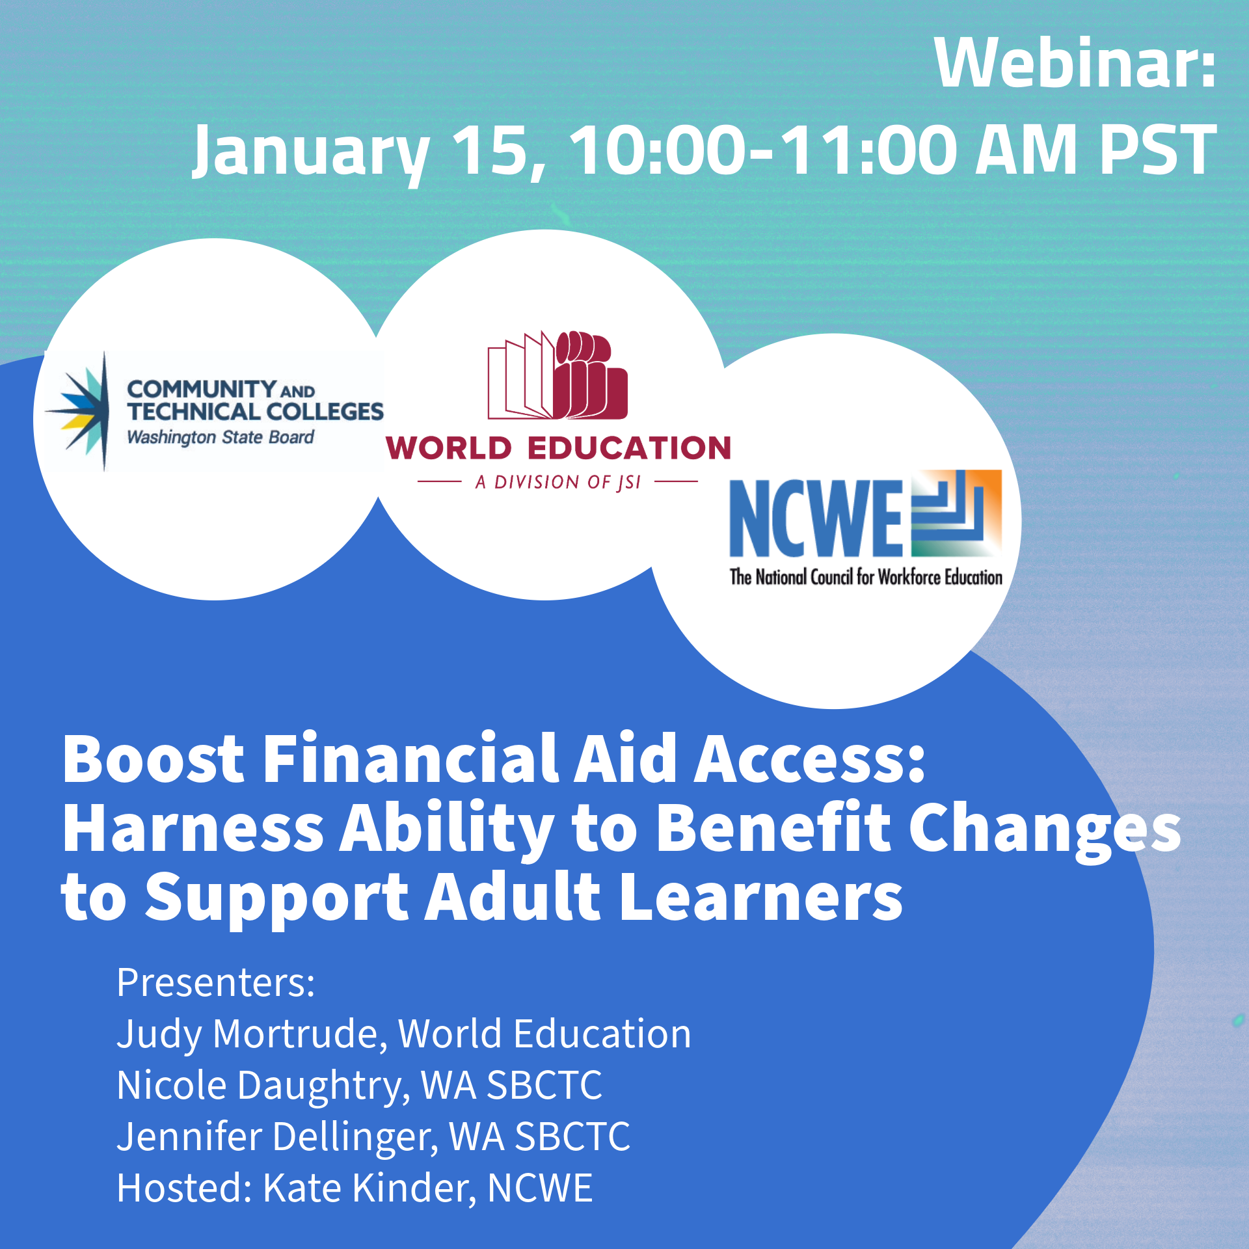

Slide 3
Why Ability to Benefit?
To Benefit:
Learners
Families
Employers
Communities
Local Economies

Slide 4
Opportunity Imperative
Nearly 28 million adults are without high school diploma or equivalency
(ACS 2023 5 yr estimates)
Postsecondary education is positively related to higher income, lower unemployment, better health and wellbeing, and increased likelihood people experience job satisfaction and have careers that fit their interests and talents (Lumina/Gallup)
By 2031, 85% of good jobs and 72% of all jobs will require some post- secondary education (Georgetown CEW)
Notes:
Citations (not for posting)
ACS 2023 5 year estimates; https://data.census.gov/table/ACSST5Y2023.S1501?q=United%20States&t=Educational%20Attainment&y=2023
https://cew.georgetown.edu/cew-reports/goodjobsprojections2031/#resources
https://www.luminafoundation.org/wp-content/uploads/2023/08/Education.for_.What_.pdf

Slide 5
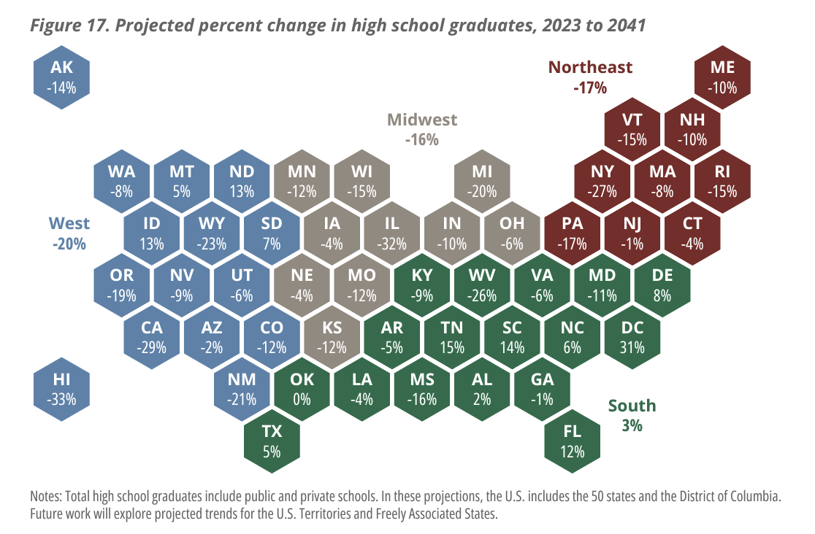
Notes:
Posting: https://www.wiche.edu/knocking/

Slide 6
What is Ability to Benefit?
Notes:
[JM]

Slide 7
What is ATB?
The Ability to Benefit (ATB) provision in the Higher Education Act gives adults without a high school diploma or equivalent access to federal student aid.
Notes:
[JM]

Slide 8
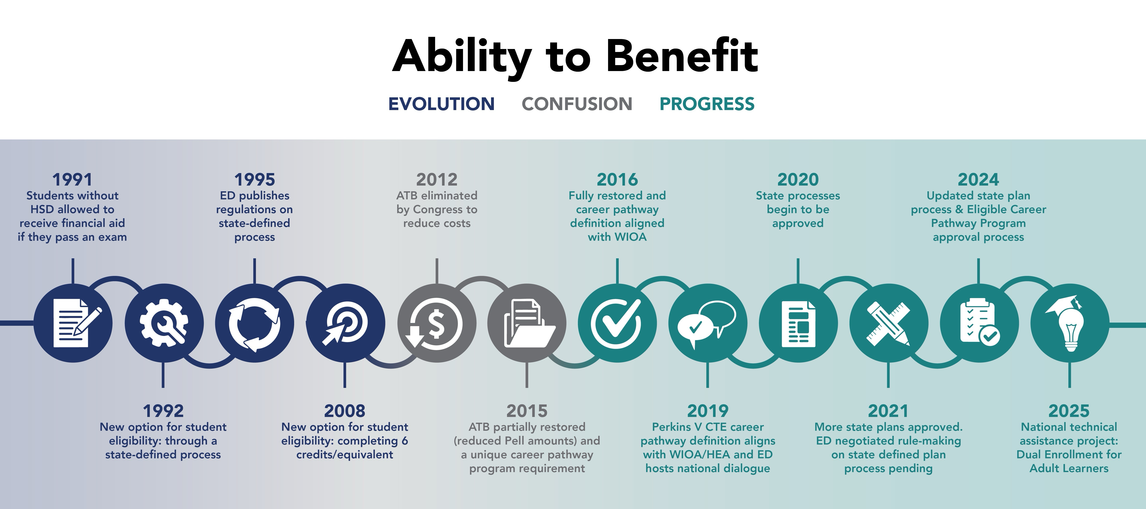
Notes:
[JM]

Slide 9
Dual Enrollment for Adult Learners
Aims to support the development of ATB alternate state processes and increase the overall usage of ATB to support the dual enrollment of adult learners in postsecondary education
Funded by OCTAE; led by Manhattan Strategy Group, in collaboration with World Education and RTI International
Notes:
[JM]

Slide 10
Student Eligibility
To be eligible for ATB, a student has to:
Be enrolled in an eligible career pathway program (ECPP);
Complete one of three options:
Pass a U.S. Department of Education-approved test,
Complete six credit hours towards a postsecondary credential, or
Be admitted through a “state defined process”; and
Be eligible for federal student aid.
Notes:
[JM]

Slide 11
Eligible Career Pathway Programs (ECPPs)
Students must be concurrently enrolled in all three of the following:
Adult education and literacy programming that assists adults in attaining a high school diploma or equivalent;
A Title IV eligible postsecondary program; and
Workforce preparation activities and training for a specific occupation or occupational cluster.
Notes:
[JM]

Slide 12
Eligible Career Pathway Programs (ECPPs)
ECPPs must also:
Align with the skill needs of the state or regional economy
Include academic and career counseling
Accelerate students’ educational and career advancement
(I.e., align with the “career pathway” definition in WIOA, HEA, and Perkins V)
Notes:
[JM]

Slide 13
The Three ATB “Options”
To be eligible for ATB, a student has to complete one of three options:
Pass a U.S. Department of Education-approved test
Complete six credit hours towards a postsecondary credential
Be admitted through a “state defined process”
Notes:
[JM]

Slide 14
Recent Changes to ATB
Notes:
[JM]

Slide 15
Eligible Career Pathway Programs (ECPPs)
New federal approval process: Institutions must demonstrate to the U.S. Department of Education (ED) that a student is enrolled in an ECPP
If the institution has an ECPP prior to July 1, 2024, the institution must 1) select one of its ECPPs for ED approval and 2) affirm that all of its ECPPs meet the documentation standards
If the institution does not have an ECPP prior to July 1, 2024, the institution must 1) have its program approved by ED as an initial ECPP and 2) affirm that all following programs will meet ECPP standards
Notes:
[JM]
You can think of the changes as covering two different topics. The first one is ECPPs. Under the new regulations, institutions using ATB must demonstrate to the U.S. Department of Education that a student is enrolled in an ECPP by having at least one ECPP approved by the U.S. Department of Ed. Previously, ED did not require this federal approval process. So what does this mean?
[Read slide.]

Slide 16
Eligible Career Pathway Programs (ECPPs)
Partnerships between postsecondary and adult education providers: “The appropriate education is offered…through an agreement, memorandum of understanding, or some other evidence of alignment of postsecondary and adult education providers that ensures the education is aligned with the students' career objectives.”
From Practitioners!
Minnesota State’s ATB State Process Partnership Checklist for AE and PSE partners
Notes:
[JM]
[Read slide.]
For one example of existing partnership documentation, Minnesota State has a really nice checklist that lays out the expectations for postsecondary and adult education partners.

Slide 17
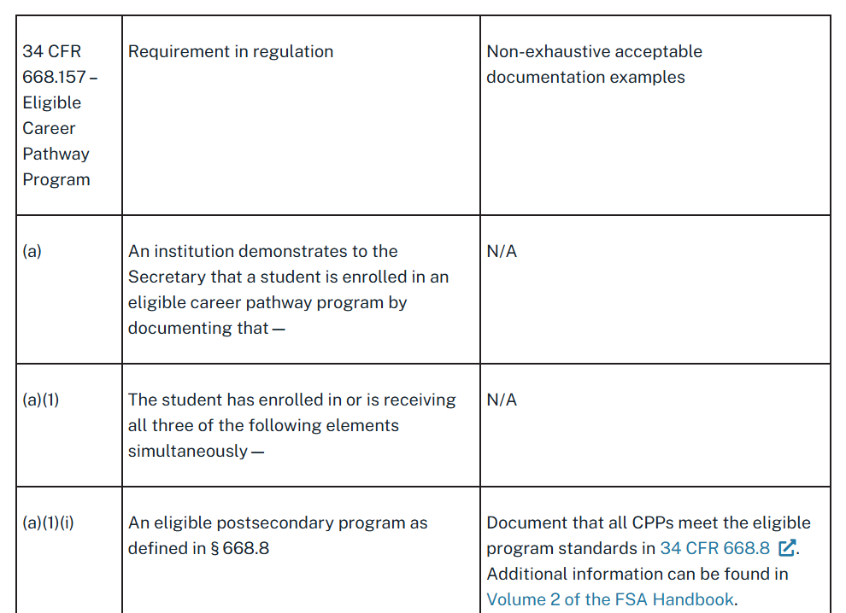
ECPP Documentation Guidance from ED
(GEN-24-08) Ability to Benefit State Process and Eligible Career Pathway Programs

Slide 18
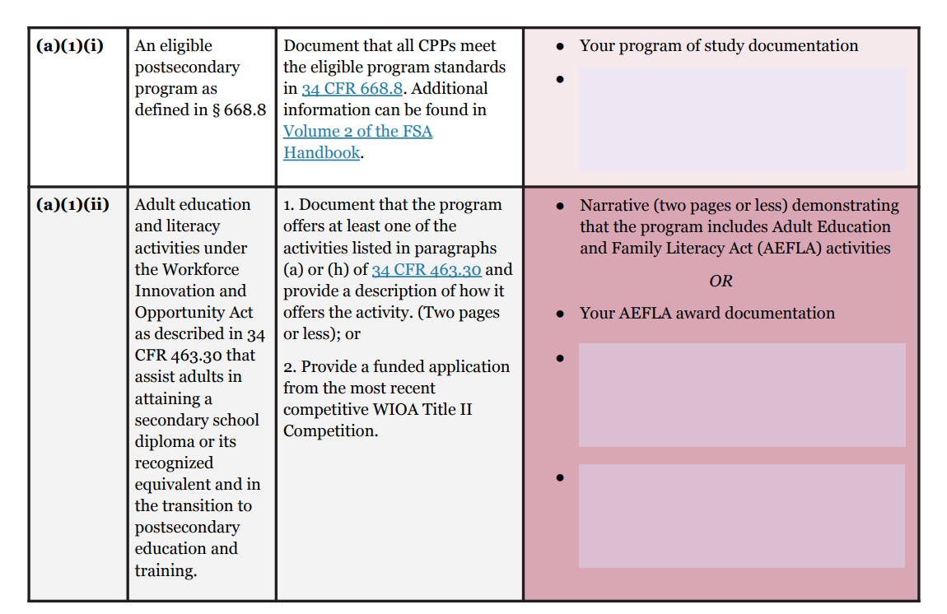
World Education’s ECPP Documentation Template
Download editable PDF: https://worlded.me/ATB-ECPP-template
Notes:
https://worlded.me/ATB-ECPP-template

Slide 19
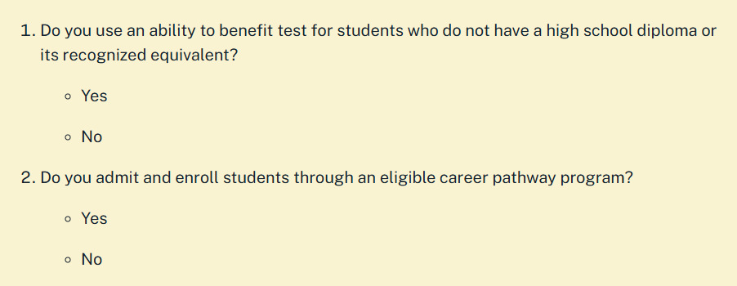
Uploading Documentation in E-App
(GENERAL-24-151) Applying for Title IV Approval of an Eligible Career Pathway Program for Ability to Benefit

Slide 20
Questions?
Judy Mortrude
Senior Technical Advisor
JSI/World Education
judy@mortrude@worlded.org
Shirley Doan
Senior Project Coordinator
JSI/World Education
shirley_doan@worlded.org
Notes:
[JM]

Slide 21
Putting Policy Into Practice

Slide 22
Ability to Benefit Washington State
January 15, 2025
Nicole Daughtry & Jennifer Dellinger

Slide 23
Washington State’s Adult Education Plan
After 20+ years of success, I-BEST remains our most successful delivery model for moving under-skilled adults to living wage jobs.
I-BEST transforms the world of adult education through contextualization
I-BEST taps the combined expertise of faculty through integrated team teaching
I-BEST provides wraparound support and navigational services to promote student retention and completion

Slide 24
High School + Defined
High School+ (HS+) is a competency-based high school diploma program for adult learners 18 and older who do not have a high school diploma or equivalency.
Adults demonstrate competencies in reading, writing and math contextualized in science, history, government, occupational studies, and digital literacy.
This can be done through alternative means including, but not limited to:
high school and college transcript credits
work, life, military experience
prior learning portfolio
credit for testing

Slide 25
Ability to Benefit Qualification
Three ways in Washington state to qualify for ATB
Achieve a cut score on an approved test (ACCUPLACER)
Earn six college credits
Co-enroll in I-BEST and High School + (the state approved process)

Slide 26
Ability to Benefit in WA State
Washington state's process allows students co-enrolled in I-BEST and our competency-based High School Plus (HS+) program to meet the core ATB student eligibility requirement and bypass the testing/credit options.
This new option saves time and money for people looking to more quickly gain the skills and credentials needed for living wage careers.

Slide 27
Ability to Benefit Equity, Access, & Support
Provides stronger equity and access to:
Workforce Education
Eligible career pathways
Industry alignment & engagement
In demand occupations
Advising and career supports
Learning outcomes
Financial Resources & Student Supports
Pell, WA College Grant, Opportunity Grant, etc.
Resource Navigation & Case management
Support Services/Basic Needs
Academic & Financial planning
Notes:
Note: Career pathways refer to a combination of rigorous and high-quality education, training, and support services that are aligned with the skill needs of industries in State or regional economies, preparing individuals to be successful in secondary or postsecondary education programs and the labor market

Slide 28
Ability to Benefit & SNAP Education & Training
Benefits Navigators
Integrated co-enrollment
Case management
Tuition, Fees, & Books
Support services: food, emergency housing, transportation, laptops/internet, childcare, etc.
Academic & financial planning
Notes:
WA State’s Basic Food Employment and Training Program supports access to education for low-income individuals eligible for federal SNAP benefits. WA state CTCs use their BFET program to support student access and funding for high wage high demand programs who would not otherwise be able to access education due to funding limitations of financial aid.
Benefits Navigators - direct connection to SNAP enrollment, food programs, and pantries.
Integrated co-enrollment - universal applications, common intakes, screening for all program eligibility, braiding funding
Case management - dedicated connection, assessments, resources, and barrier removal
Tuition, Fees, Books - supports the 3 ways of accessing ATB, most common is the paying for 6 credits
Support services - additional access to supports to meet basic needs while they are pursuing education
Academic and financial planning - looks at immediate, short term, and long term financial plan that align with career pathway

Slide 29
ATB ECPP Resources & Support
State level ATB Workgroup
Workforce Education
Student Services/Student Support Programs
Corrections Education
Basic Education for Adults
Quarterly ATB Desk Audits and Data Tracking
Statewide ATB Webinars with accompanying Q & A documents
ATB ECPP Matrix
Technical support for ATB implementation and expansion

Slide 30
Questions?
Nicole Daughtry
Policy Associate, I-BEST | ATB | IELCE
Washington State Board for Community & Technical Colleges
ndaughtry@sbctc.edu | 360.704.4368
Jennifer Dellinger
Policy Associate, Workforce Education/Student Services, Student Support Programs
Washington State Board for Community & Technical Colleges
jdellinger@sbctc.edu | 360.704.4339

Slide 31
Questions? What’s Next?

